Slide 1
Educational Game for VR
Developed and Presented by Donald Brant, Alan Lam, & Jose Romero
Notes:
Hello. I’m Donald Brant and here with me are my team members Alan Lam and Jose Romero. For our project we’ve set out to develop an education game for VR.

Slide 2
Project Goals
Develop an immersive, educational PC VR experiences
Provide educational tutorials to teach life skills such as cooking and car maintenance
Provide a simple method for reviewing flashcards in VR
Notes:
Our main goal with this project is to develop an educational tool that leverages VR’s strength of immersion in order to create a fun and engaging learning experience for our users.
To that end we’re creating directed tutorials that walk users through learning life skills such as cooking and performing simple car maintenance.
We’re also developing a flashcard mode that aims to give a traditional flashcard material review experience with digital convenience.

Slide 3

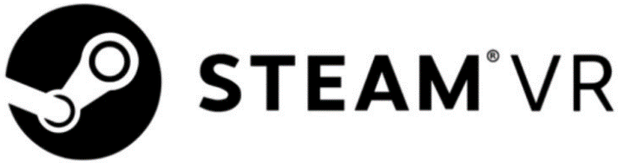
Technologies Used
Notes:
We’ve built our game in Unity, an extremely popular multiplatform game engine used in a wide range of popular games from Temple Run to Beat Saber.
On top of that we’ve utilized SteamVR integration through the SteamVR Unity plugin which allows us to greatly simplify the process of targeting multiple VR platforms by baking in HMD support for all major VR platforms and abstracting or generalizing controls between those platforms.

Slide 4
Implemented Flashcard Features
Easy input method for users to create custom flashcards (.csv)
Dynamic ‘Omnicard’ display
Input to allow the user to move onto the next card
Notes:
This sprint we’ve started to implement the flashcard level.
We’ve already implemented a method for user input of custom flashcards which we’re handling through a CSV file in the game directory. Users can simply edit this file with their spreadsheet software of choice, putting the front text for cards in the first column and the back text for cards in the second column, and their custom flashcards will appear in game.
To the display the cards we determined that a stack of n cards in VR would be a bit… cumbersome so we opted for a single card solution that I’ve dubbed the Omnicard.

Slide 5
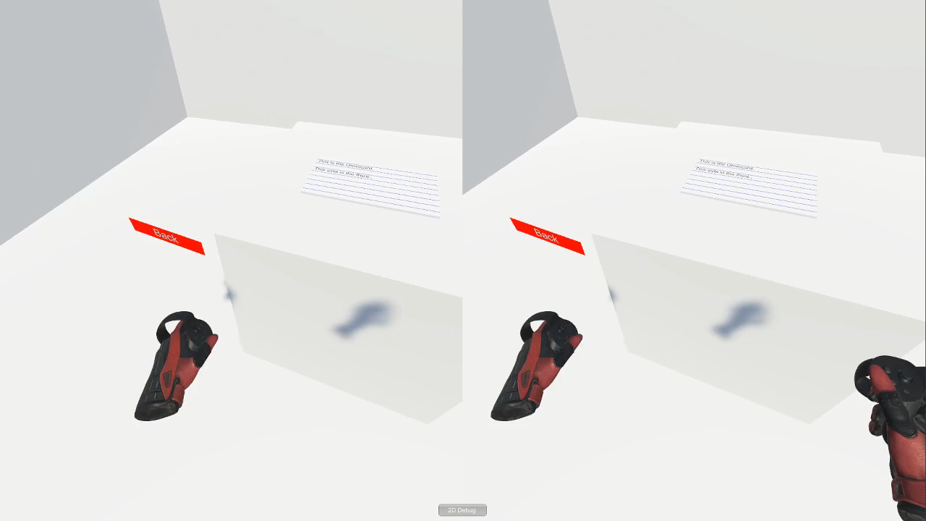

Slide 6
Upcoming Flashcard Features
Card shuffling
Allowing users to mark cards as ‘learned’
Built in flashcard sets associated with the other levels of the game

